Slide 1
What is Data Science
Haiyan Cheng
Willamette University
CS-429
Spring 2018

Slide 2
Big data and Data Science Hype
Lack of definition around basic terminology
Lack of recognition of researchers in academic and industry
The hype is crazy
Statisticians feels like it’s a rebranding (50 years of data science)
May not be a true science but more of a craft

Slide 3
Getting past the hype
Data science is something new-it has access to a large body of knowledge and methodology as well as a process that has foundations in both statistics and computer science

Slide 4
Why now?
Massive amount of data about many aspects of our lives (Internet data, finance, medical industry, pharmaceuticals, bioinformatics, social welfare, government, education, retail...)
An abundance of inexpensive computing power

Slide 5
From data to data products
Amazon recommendation systems
Friend recommendations on Facebook
Film and music recommendations
Credit rating
Trading algorithms and models
Dynamic personalized learning and assessment
........

Slide 6
A feedback loop
Our behavior changes the product
The product changes our behavior
Technology
Infrastructure for large-scale data processing
Increased memory and bandwidth
Breakthrough of algorithms: machine learning, data mining, fundamental advancement in CS, Math and statistics.
Powerful models to produce increasing amount of volume of data
Cultural acceptance of technology

Slide 7
Ethics consideration
Data collection
Data processing
Security
Ethical responsibility and technological responsibility
...

Slide 8
Datafication
“The rise of big data” by Kenneth Neil Cukier & Viktor Mayer-Schoenberger
A process of “taking all aspects of life and turning them into data”
Examples:
Quantify friendships with “likes”
Google’s augmented-reality glasses datafy the gaze
Twitter datafies stray thoughts
LinkedIn datafies professional networks

Slide 9
Are you aware you are being datafied?
Web cookies
Phone location service
Sensors
Cameras
Google glass

Slide 10
Perspective of datafication
“Once we datafy things, we can transform their purpose and turn the information into new forms of value.”
Who is “WE”? What are the “VALUE”

Slide 11
Modelers
Business owner, entrepreneurs
Getting people to buy stuff
Increased efficiency
Welfare of human being

Slide 12
Opinion 1 of Data Science
Metamarket CEO Mike Driscolli (on Quora discussion from 2010 on “What is Data Science”):
Data Science, as practiced, is a blend of Red-Bull-fueled hacking and espresso-inspired statistics.
But data science is not merely hacking—because when hackers finish debugging their Bash one-liners and Pig scripts, few of them care about non-Euclidean distance metrics.
And data science is not merely statistics, because when statisticians finish theorizing the perfect model, few could read a tab-delimited file into R if their job depended on it.
Data science is the civil engineering of data. Its acolytes possess a practical knowledge of tools and materials, coupled with a theoretical understanding of what’s possible.

Slide 13
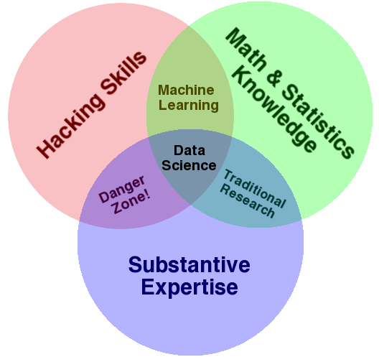
Opinion 2 of Data Science
Drew Conway’s Venn diagram of data science

Slide 14
Opinion 3 of Data Science
Vasant Dhar, in the article “Data Science and Prediction”, Communications of the ACM, Dec 2013, makes the following three big points:
Data Science is the study of the generalizable extraction of knowledge from data.
• A common requirement in assessing whether new knowledge is actionable for decision making is its predictive power, not just its ability to explain the past.
• A data scientist requires an integrated skill set spanning math, ML, statistics, computer science, along with a deep understanding of the craft of problem formulation to engineer effective solutions.

Slide 15
A data science profile
Computer Science
Math
Statistics
Machine learning
Domain expertise
Communication and presentation skills
Data Visualization

Slide 16
What is your data science profile
Computer Science
Math
Statistics
Domain expertise
Communication and presentation skills
Data Visualization
Python
R
Matlab

Slide 17
Appreciating Data
Computer Scientists do not naturally appreciate data: it’s just stuff to run through a program
The usual way to test algorithm performance is to run the implementation on “random data”
BUT...
Interesting data sets are a scarce resource, which requires hard work and imagination to obtain.

Slide 18
Computer Scientist vs Real scientists
Scientists strive to understand the complicated and messy natural world, while computer scientists build their own clean and virtual worlds. Thus:
Nothing is ever completely true or false in science, while everything is either true or false in computer science/mathematics

Slide 19
Computer Scientist vs Real scientists
Scientists are data-driven, while computer scientists are algorithm-driven.
Scientists obsess about discovering things, which computer scientists invent rather than discover.

Slide 20
Genius vs Wisdom
Software developers are hired to produce code
Data scientists are hired to produce insights.
Genius shows in finding the right answer.
Wisdom show in avoiding the wrong answers.
Data science benefit more from wisdom than from genius.

Slide 21
Developing Wisdom
Wisdom comes from experience
Wisdom comes from general knowledge
Wisdom comes from listening to others
Wisdom comes from humility, observing how often you have been wrong and why/how.

Slide 22
Developing curiosity
The good data scientist develop a curiosity about the domain/application they are working in.
They talk with the people whose data they are working on.
They read the newspaper every day, to get a broader perspective on the world.

Slide 23
Asking good questions
Software developers are not encouraged to ask questions, but data scientists are:
What exciting things might you be able to learn from a given data set?
What things do you/your people really want to know?
What data sets might get you there?

Slide 24
Let’s practice asking questions!
Who, what, where, when and why on the following datasets:
Baseball-reference.com (Babe Ruth)
Summary statistics of each years batting, pitching, and fielding record, with teams and awards.

Slide 25
Baseball questions:

Slide 26
Baseball questions:
How to best measure individual player’s skill, value or performance?
How fair do trades between teams work out?
What is the trajectory of player’s performances as they mature and age?
To what extend does batting performance correlate with the position played?

Slide 27
Demographic questions:

Slide 28
Demographic questions:
Do left-handed people have shorter lifespans than right-handers?
How often do people return to where they were born?
Do player salaries reflect past, present, or future performance?
Are heights and weights increasing in the population?

Slide 29
Let’s practice asking questions!
Who, what, where, when and why on the following datasets:
International Movie Database (IMDB) (Brad Pitt)

Slide 30
Movie questions:

Slide 31
Movie questions:
Can we predict how well people will like a movie? What about its gross?
What does the social network of actors look like (Six degrees of Kevin Bacon)
What is the age distribution of actors and actresses in film?
Do stars live longer or shorter lives than the bit players or public?

Slide 32
Roles of a data scientist
In Academia
No one really calls themself data scientist
People interested in figuring out says to solve important problems, often of social values, with data
A scientist, trained in anything from social science to biology, who works with large amount of data, and must grapple with computational problems posed by the structure, size, messiness, and the complexity and nature of the data, while simultaneously solving a real world problem.

Slide 33
Roles of a data scientist
In Industry
Depends on the level of seniority
A chief data scientist
Setting the data strategy of the company (engineering, infrastructure for collecting, logging, privacy, decision making, data product, setting research goals)
Manage a team of engineers, scientists and analysts.
Communicate with leadership: CEO, CTO,...
Data scientist
Knows how to extract meaning from and interpret data
Requires tools and methods from statistics and ML
Collecting, cleaning, munging data, perform EDA, find pattern, build models and algorithms.
Help with data-driven decision making

